Slide 1
-Technology trends that impact Information Management practices.
The meaning of Information - Information as Thing
Michael K. Buckland, in the Journal of the American Society For Information Science, describes information with three distinct characteristics, one of them being Information-as-Thing…”The nature and characteristic of “information-as-thing” are discussed, using an indirect approach (“What things are Informative?”). Varieties of “Information-as-thing” include data, text, documents, objects, and events”(351).
- Ambiguity of delivering information - User vs. Machine

Slide 2
-Technology trends that impact Information Management practices.
Information theory - Can machines think?
According to James Gleick, in the early 1943, two cryptanalysts Claude Shannon and Alan Turing at Bell Labs theorized about the ability of machines learning to think. And the way they imagined this process was by feeding “cultural-things” in other words “Information-as-Things” into an electronic brain.
James Gleick in his writing ponders about this concept and how do we answer this very question, given what we know today:
“Can machines think? Was a question with a relatively brief and slightly odd tradition-…Charles Babbage and Ada Lovelace lay near the beginning of this tradition,…and now the trail led to Alan Turing, who did something really outlandish: thought up a machine with ideal powers in the mental realm and showed what it could not do”(205).
- Information - User vs. Machine

Slide 3
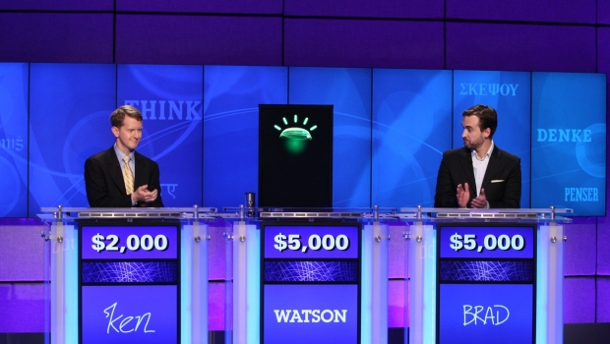
-Technology trends that impact Information Management practices.
In February 2011 a cognitive system developed by IBM with the name Watson plays the game-show Jeopardy

Slide 4
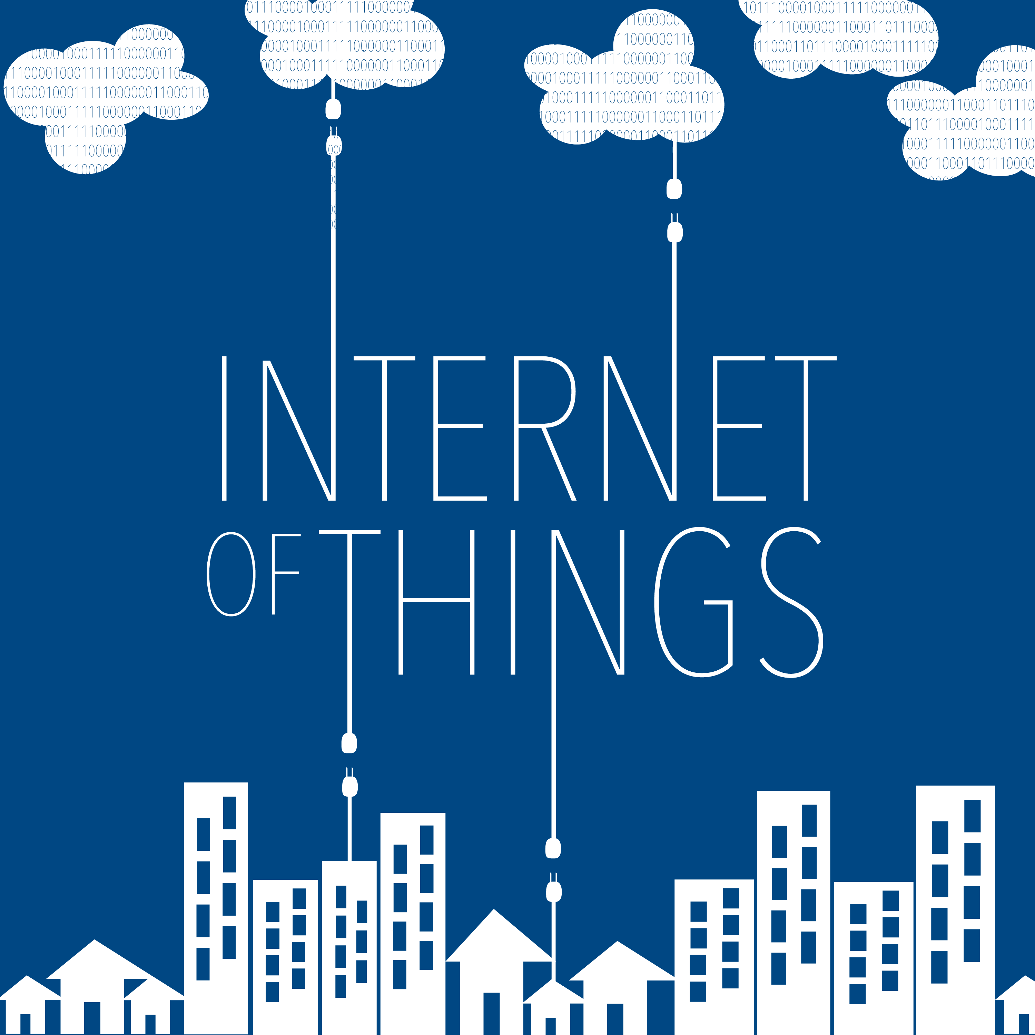
Source: https://ssl-static.libsyn.com/p/assets/b/8/4/b/b84b5404c2f633ab/IOT-podcast-12.png

Slide 5
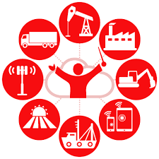
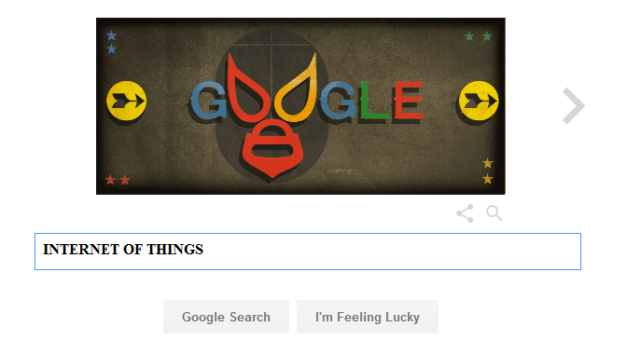
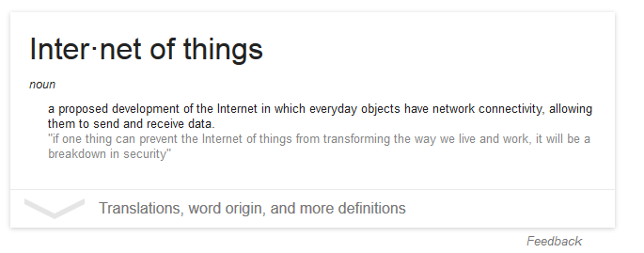

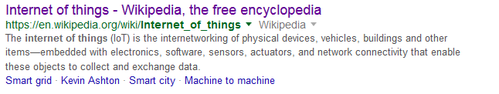
-Internet of Things (IoT)

Slide 6

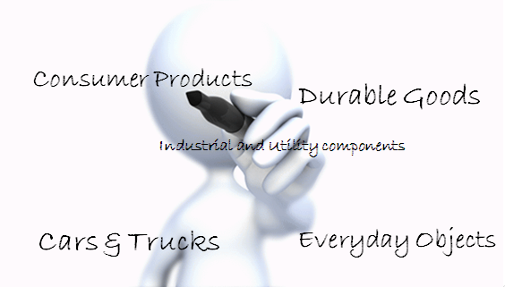
-Internet of Things (IoT)
Internet of Things is not only impacting Information Management practices, but also an emerging topic of technical, social and economic significance.
By 2025 is anticipated 100 billion IoT devices will be connected, with a global economic impact of more than $11 trillion dollars.
Consumer Products
Durable Goods
Industrial and Utility components
These devices combined with internet connectivity and data analytics will fundamentally change the way we live.
Cars & Trucks
Everyday Objects

Slide 7
-Internet of Things (IoT)
Definition – What is IoT?
Techopidia defines IoT as: “…a computing concept that describes a future where everyday physical objects will be connected to the Internet and be able to identify themselves to other devices”.
In addition the postscapes website contains an array of sources for definitions on IoT. From my research I have concluded that while the concept to describe IoT is similar there is no single universal definition.
The fundamental concept for IoT is network connectivity with some sort computation processing that extends the capability of everyday components or objects that are not computers. IoT devices will either exchange, consume or generate data with little or no user intervention.

Slide 8
-Internet of Things (IoT)
Technology– Network of Networks
Connectivity Models:
Device-to-Device, Device-to-Cloud, Device-to-Gateway, Back-End Data-Sharing
Trends that are driving IoT:
Everywhere Connectivity - wireless services makes almost everything “connectable”
IP-Based Net Adoption – A global network standard that provides a well-define platform.
Moore’s law - continuous to be a factor “greater power, lower price, smaller components”
Data Analytics –powerful algorithms, vast quantities of data and dynamic datasets
Cloud Computing – Leverages remote network computing to manage and process data

Slide 9
-Internet of Things (IoT)
Technology – IoT Applications
SETTING | EXAMPLE
Human | Devices attached to the body | wearable & ingestibles
Home | Home controllers and security systems | Nest
Retail | Stores, Banks | Self-checkout, inventory optimization
Offices | Energy Management, Security, Mobile Employees
Factories | Repetitive work routines, production efficiency
Worksite | Oil and Gas, construction
Vehicles | Cars, trucks, ships, aircraft, trains, pre-sales analytics
Cities | Adaptive traffic control, smart meters, monitor
Agriculture | Railroad, autonomous machinery,

Slide 10
-Internet of Things (IoT)
Challenges –
Security:
Poorly secured IoT devices can potentially serve as entry ports for cyber-attacks that could tamper with device operability or data theft.
Privacy:
IoT devices collect and incredible amount of unique data of their surroundings. The concerns with regard individual privacy choices, and personal data is redefining the debate about privacy issues. IoT amplifies the potential for surveillance, tracking, erroneous digital profiling and difficulty to opt-out of certain data collection.
Legal:
Data collected by IoT is susceptible to misuse. For instance data transmission -collection between two different jurisdictions with different data protections laws. Conflicts with law enforcement surveillance and civil rights.

Slide 11
-Internet of Things (IoT)
Conclusion –
The IoT is happening now, and is making our today a “smart-world” with significant social and economic benefits. This includes areas of sustainable agriculture, environmental conservation, healthcare, and responsible industrialization.
There are many challenges associated with IoT that need to be addressed, on one hand the rapid change with technology outpaces our ability to get hold of regulatory structures that can adapt to effective policies, but in the other, the potential benefits promises a revolution in the way we see the world today.

